Slide 1
1 John 1:5-10 (NIV)
5 This is the message we have heard from him and declare to you: God is light; in him there is no darkness at all.
6 If we claim to have fellowship with him yet walk in the darkness, we lie and do not live by the truth.
7 But if we walk in the light, as he is in the light, we have fellowship with one another, and the blood of Jesus, his Son, purifies us from all sin.

Slide 2
1 John 1:5-10 (NIV)
8 If we claim to be without sin, we deceive ourselves and the truth is not in us.
9 If we confess our sins, he is faithful and just and will forgive us our sins and purify us from all unrighteousness.
10If we claim we have not sinned, we make him out to be a liar and his word has no place in our lives.

Slide 3
Life, Light & Love

Slide 4
Life, Light & Love
God is Light – Sue de Pyle
1 John 1:5-10

Slide 5
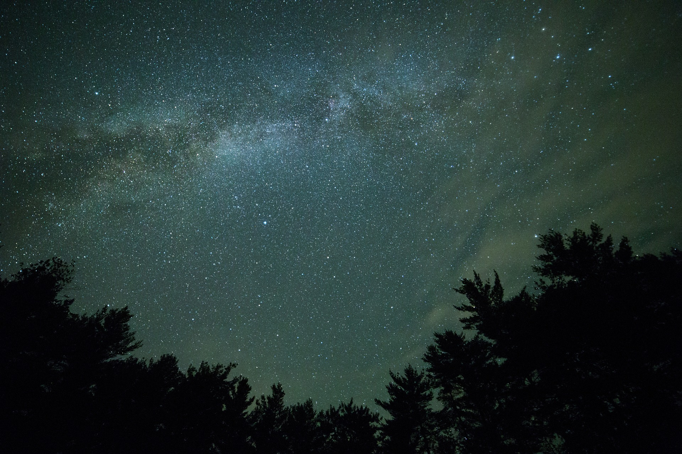

Slide 6
God is Light 1 John 1:5-10
BACKGROUND
John writing to the early church
Begins 1 John by testifying to Jesus’ godly authority and pointing out that John’s testimony was a first hand account.
Addressing issues that were arising in the early church
False prophets within the church teaching untruth and causing division.

Slide 7
God is Light 1 John 1:5-10
6 “If we claim to have fellowship with him and yet walk in the darkness, we lie and do not live out the truth.”
Light dispels the darkness
Light helps us to discern truth

Slide 8
God is Light 1 John 1:5-10
8 “If we claim to be without sin, we deceive ourselves and the truth is not in us.”
God’s light shines in our hearts and minds
God’s light reveals truth and banishes lies and doubt that can cloud our understanding
"Your word is a lamp to my feet and a light to my path" (Psalm 119:105).

Slide 9
God is Light 1 John 1:5-10
5 “This is the message we have heard from him and declare to you: God is light; in him there is no darkness at all.”
Display of God’s holiness and purity
Important for atonement, the perfect sacrifice

Slide 10
God is Light 1 John 1:5-10
9 “If we confess our sin he is faithful and just and will forgive us our sins and purify us from all unrighteousness.”
God's light brings hope and salvation.
God's light brings hope to those lost in darkness of sin.
Offers the opportunity to be saved and reconciled to Him.

Slide 11
God is Light 1 John 1:5-10
7 “But if we walk in the light, as he is in the light, we have fellowship with one another and the blood of Jesus, his son, purifies us from all sin.”
Living in the light results in a right relationship with God and healthier relationships with each other.

Slide 12
God is Light 1 John 1:5-10
How do we become people of God’s light?
Accept God’s gift of salvation.
Seek to live in accordance with God’s truth.
Confess our sin to God and ask for forgiveness.
Study God’s word.
Let God’s light shine through us.

